Slide 1

Airline Customer Satisfaction Data Analysis and Predictions
Business Insights : Predicting the Customer Satisfaction using RANDOM FOREST Algorithm
By Mitesh Desai ( NU ID 002953596 )
Final Project for INFO 6105 Data Science Engineering Methods and Tools - Spring 2022

Slide 2

CONTENTS
01
Project Charter & Problem Statement
02
Data Set Features & Pre-Processing
03
Initial Model Training & Parameters Tuning
04
Insights and Cross Verifications with K Fold
05
Conclusions & Final Remarks

Slide 3
Project Charter
The purpose of this project is:
Fine-tune the parameters and refit the model to improve efficiency & performance
Predict Customer Sat for any Airlines based on current features
Pre-process & analyze Airline Customer Satisfaction survey data set
04
01
02
03
04
05
Train the Random Forest algorithm model using the processed dataset
Determine the most important factors for Customer Sat so that Airline can focus on those

Slide 4
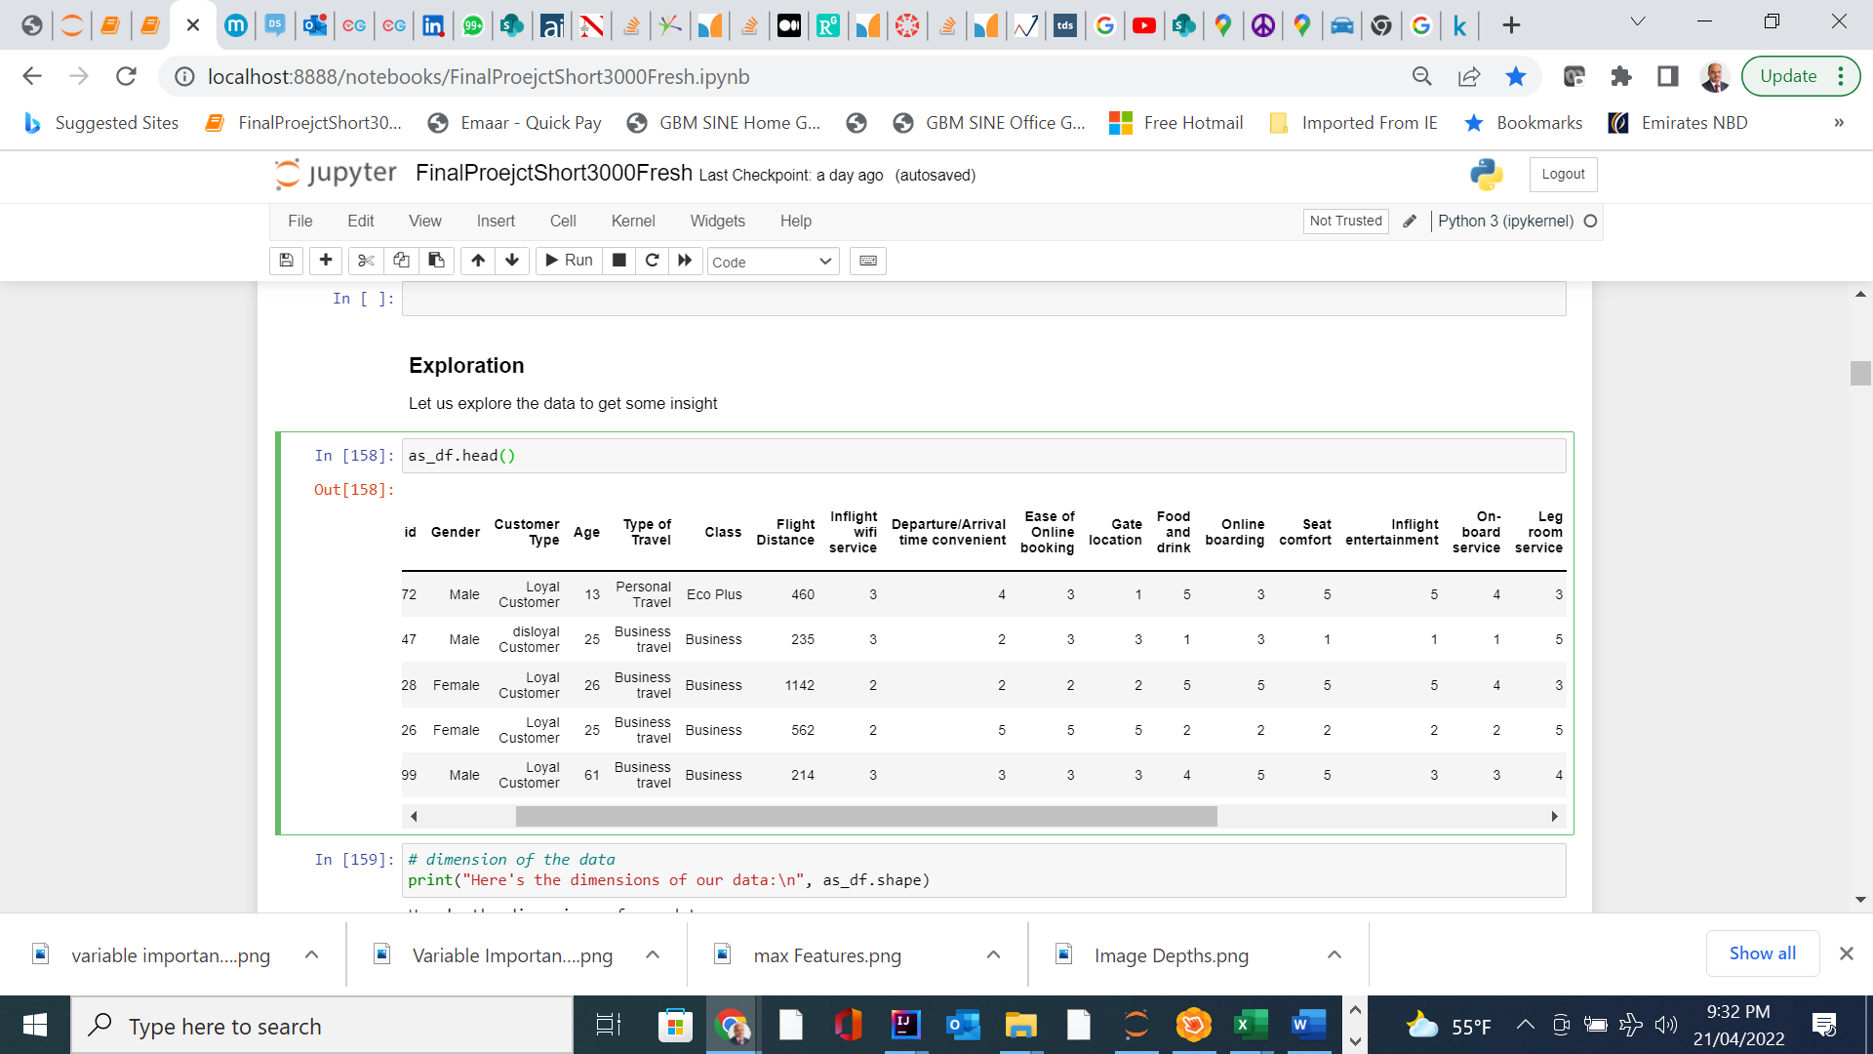
Let us study & understand our Data Set
Thousands of observations and 25 features. Few Categorical and mostly numerical features. A very rich data set – Courtesy : Kaggle.Com : TJ KLEIN
01

Slide 5
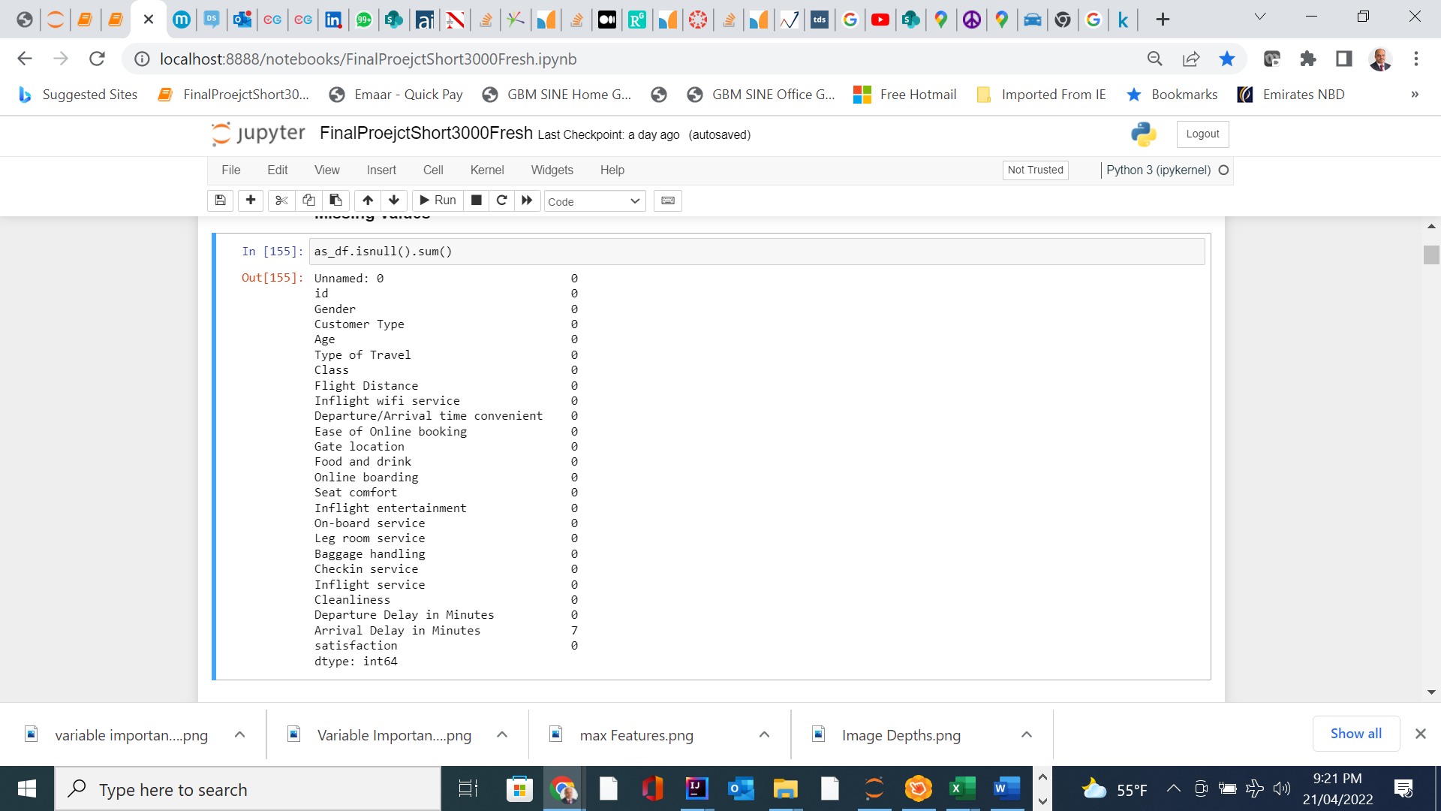

Null Values Treatment
There are null values which we need to process .
02

Slide 6
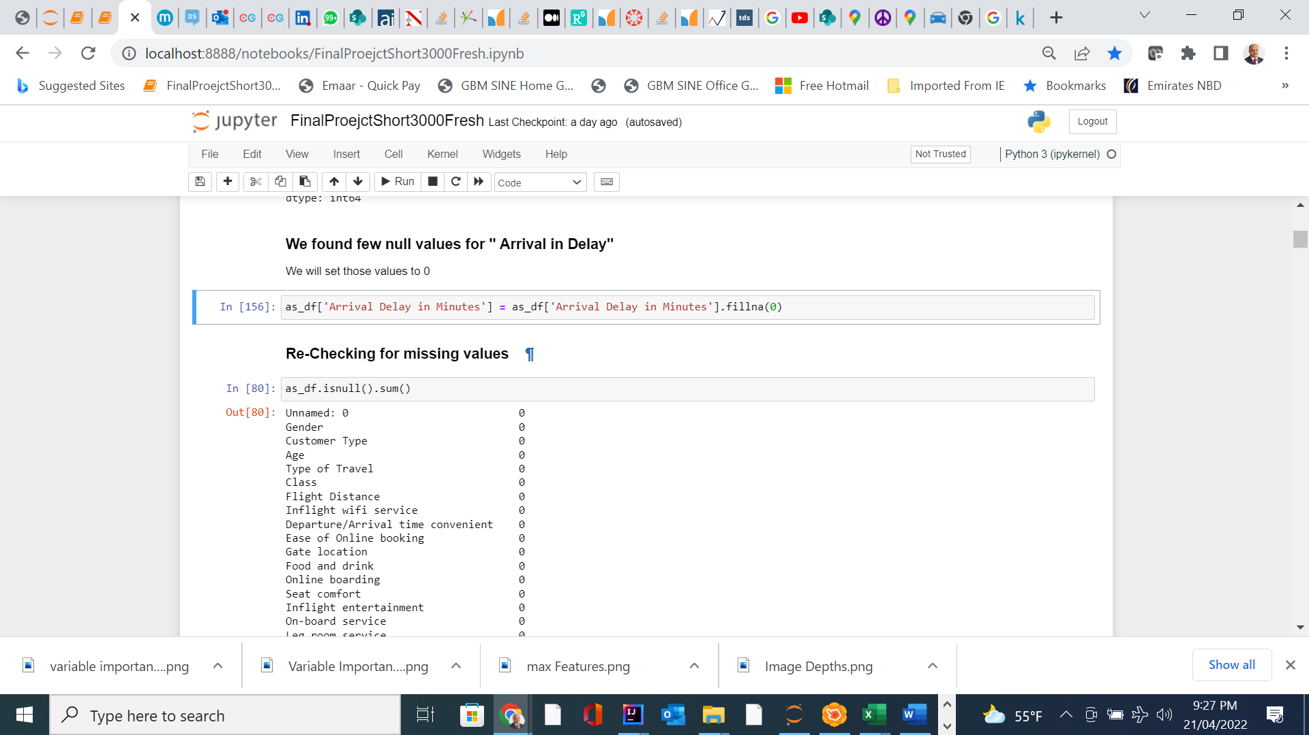
Null Values Treatment
We replaced the Null Values with 0
03

Slide 7
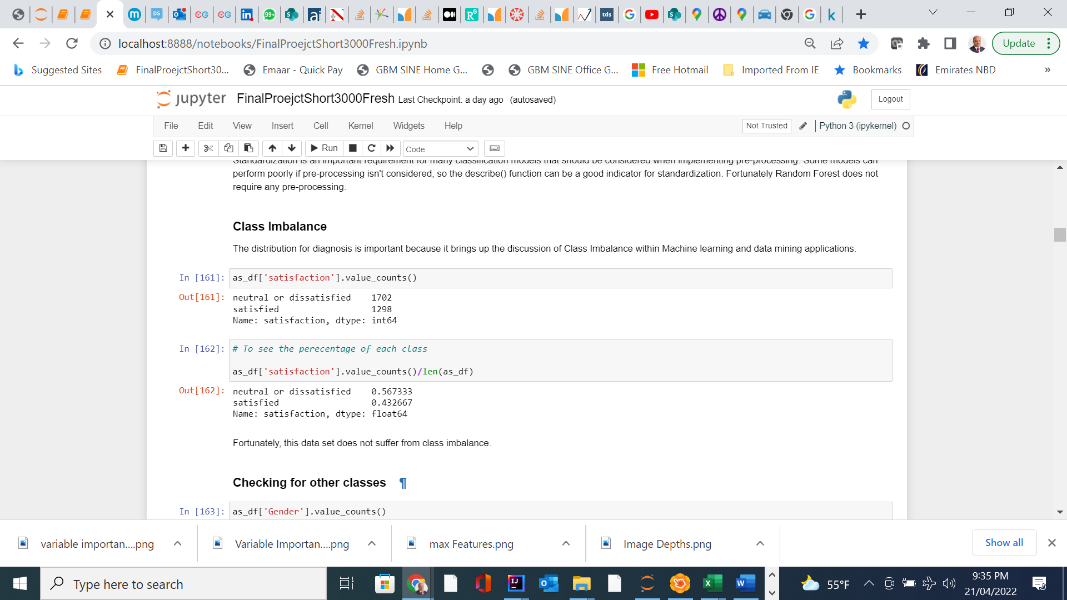
Checking for Class Imbalance
Our Data Set is Balanced
04

Slide 8
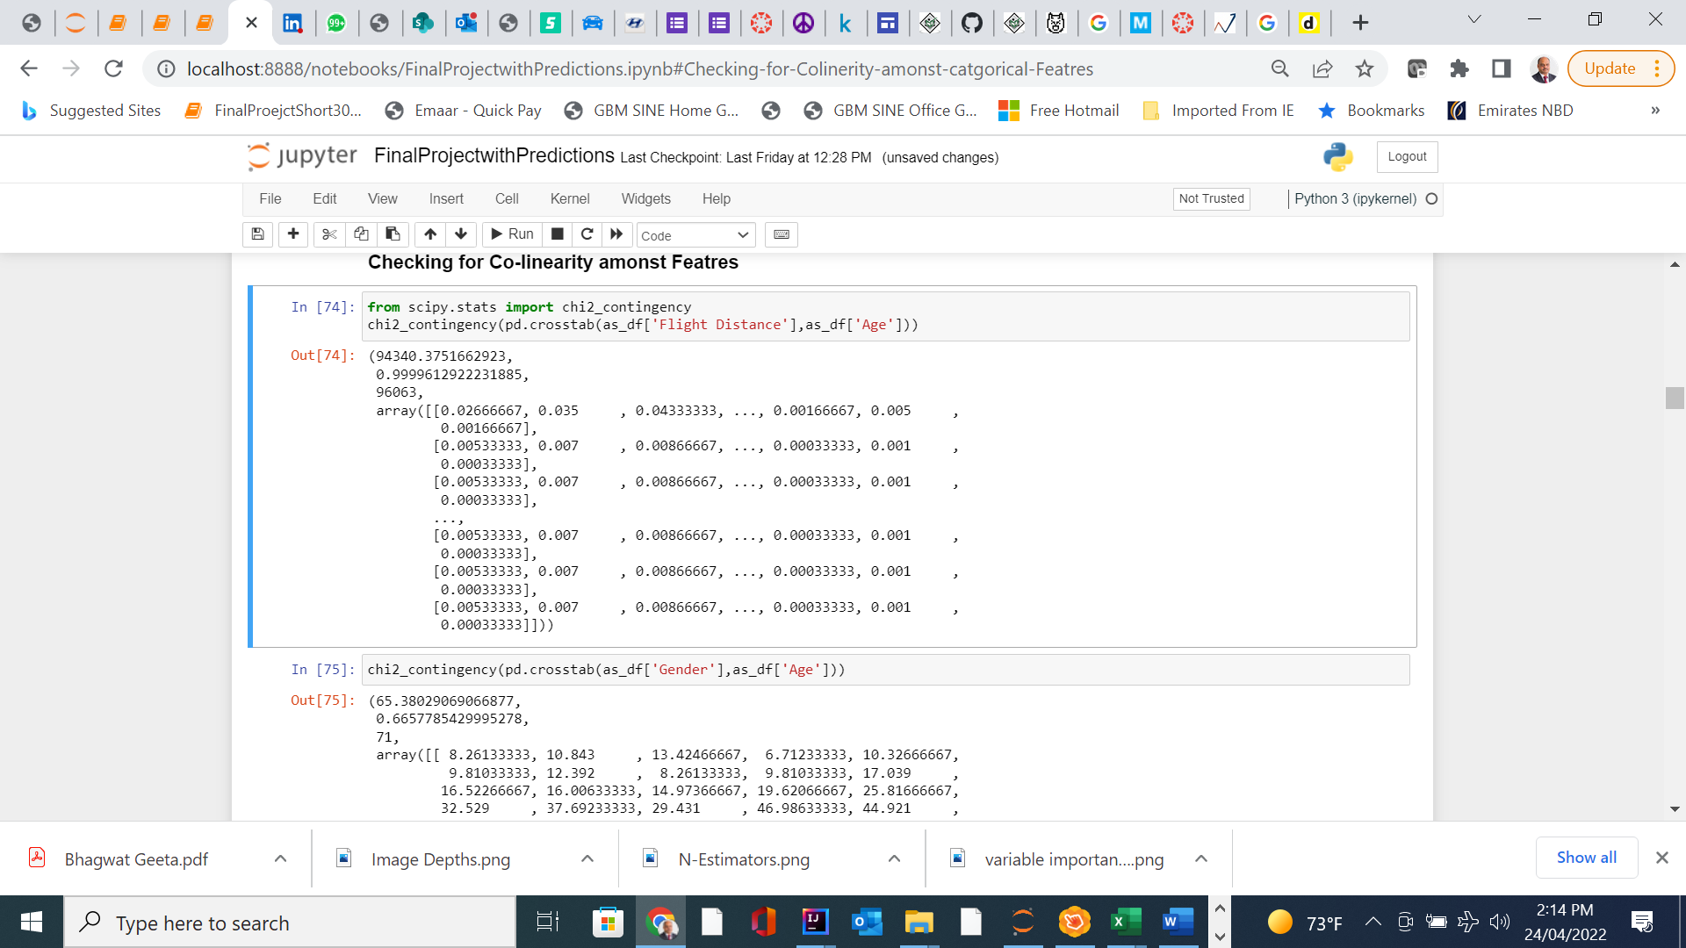
Checking for Co-Linearity
06

Slide 9
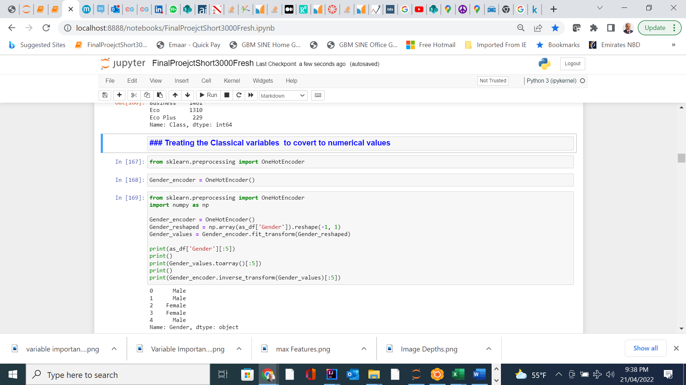
Treating the Categorical variables
Converting those to numerical values
05

Slide 10
We will create Training & Test Data Sets
We will fit Random Forest Algorithm to our Data Sets
We will identify the variable importance .n-estimators, AUC
We will fine tune the parameters & re-fit our model
We will re-run those steps and check our model’s accuracy
We will use K Fold to split our data set and cross verify our model’s accuracy
We will tune the model
Next Steps

Slide 11
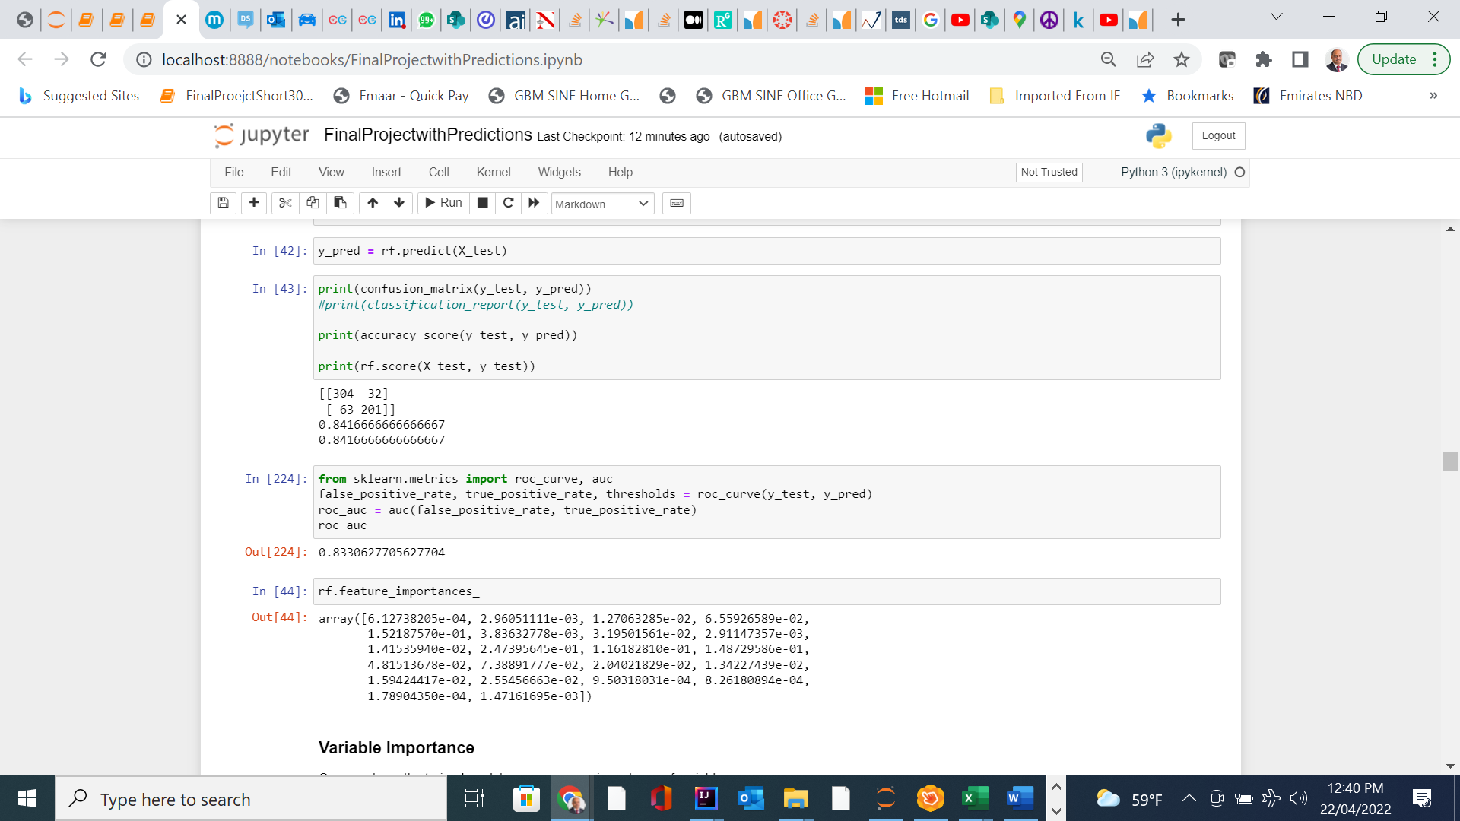
Creating Training & Test Data set & fitting the model
01

Slide 12
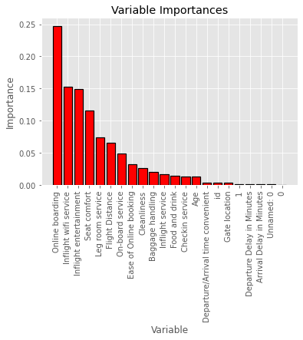
Features importance

Slide 13
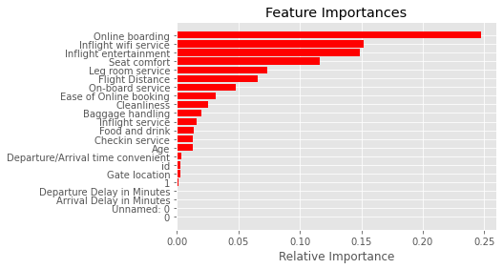
Features importance- Another way
02

Slide 14
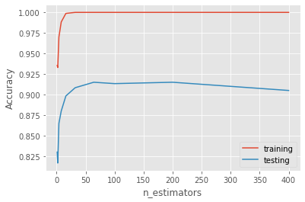
Accuracy vs estimators

Slide 15
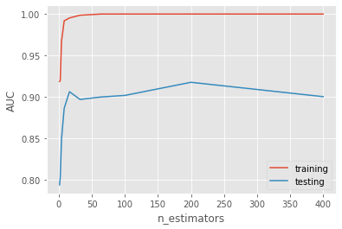
Area under the Curve

Slide 16
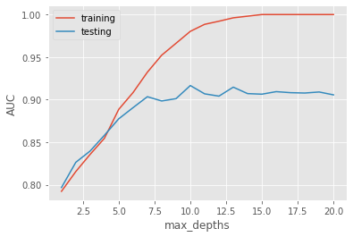
Max-depths

Slide 17
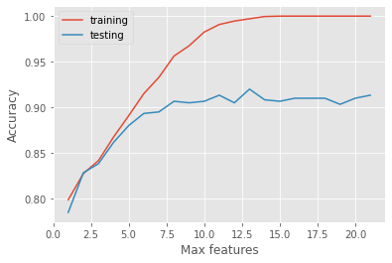
Max-features

Slide 18
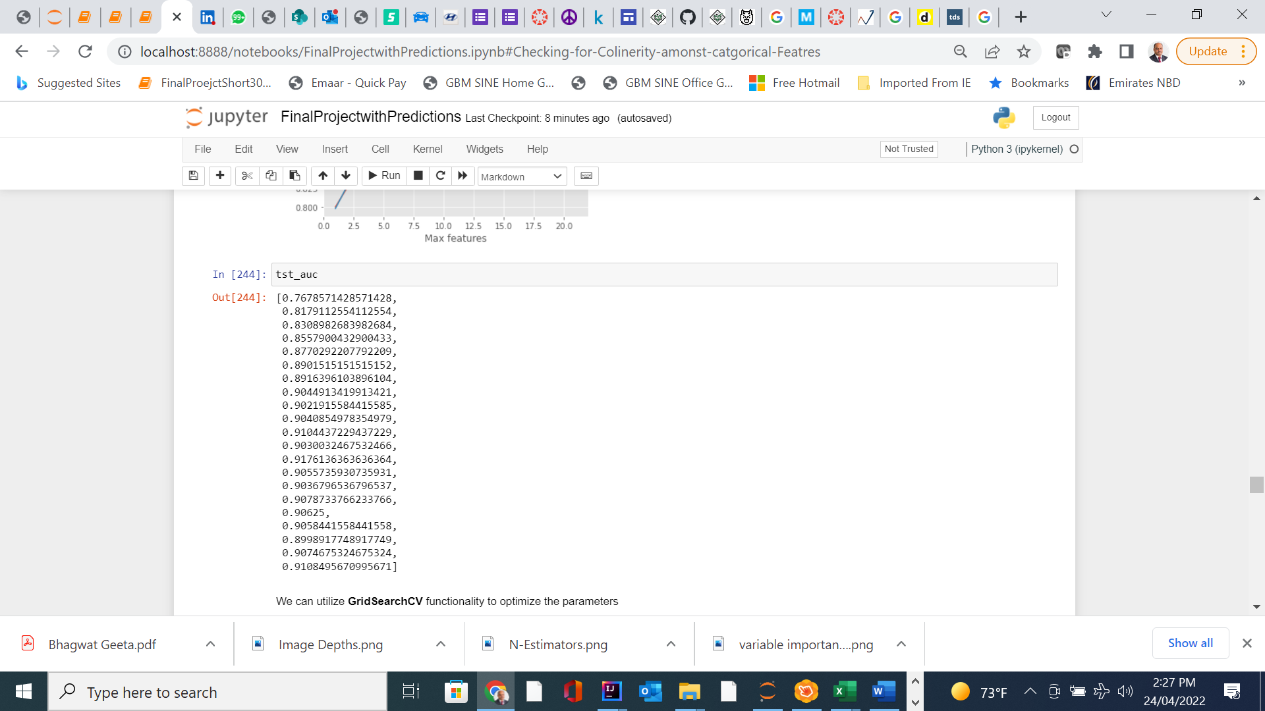
tst-auc results

Slide 19
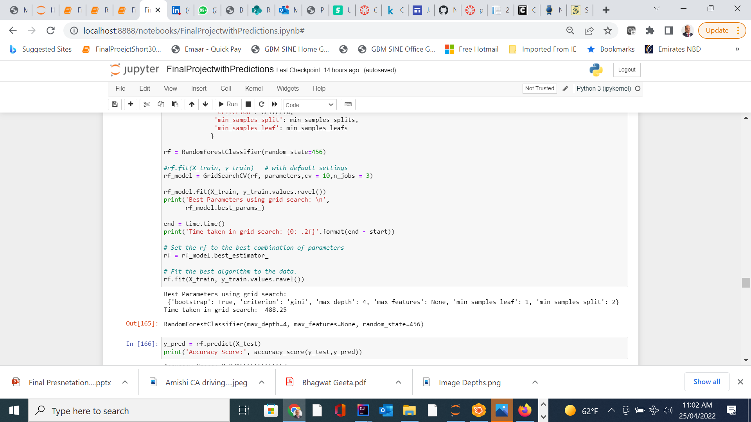
Using GridSearch CV Functionality

Slide 20
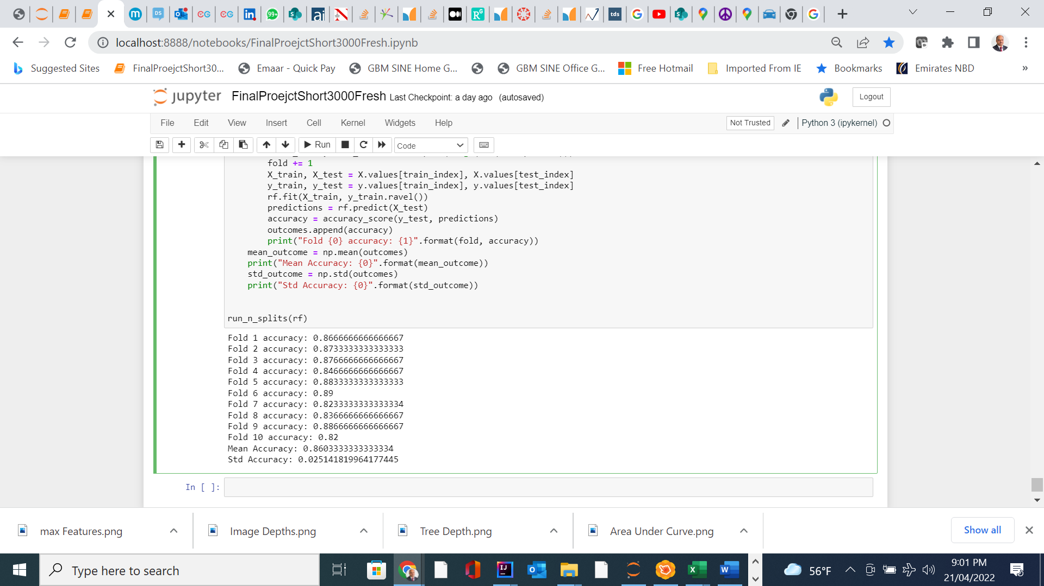
Splitting Data & K Fold Cross Verification

Slide 21
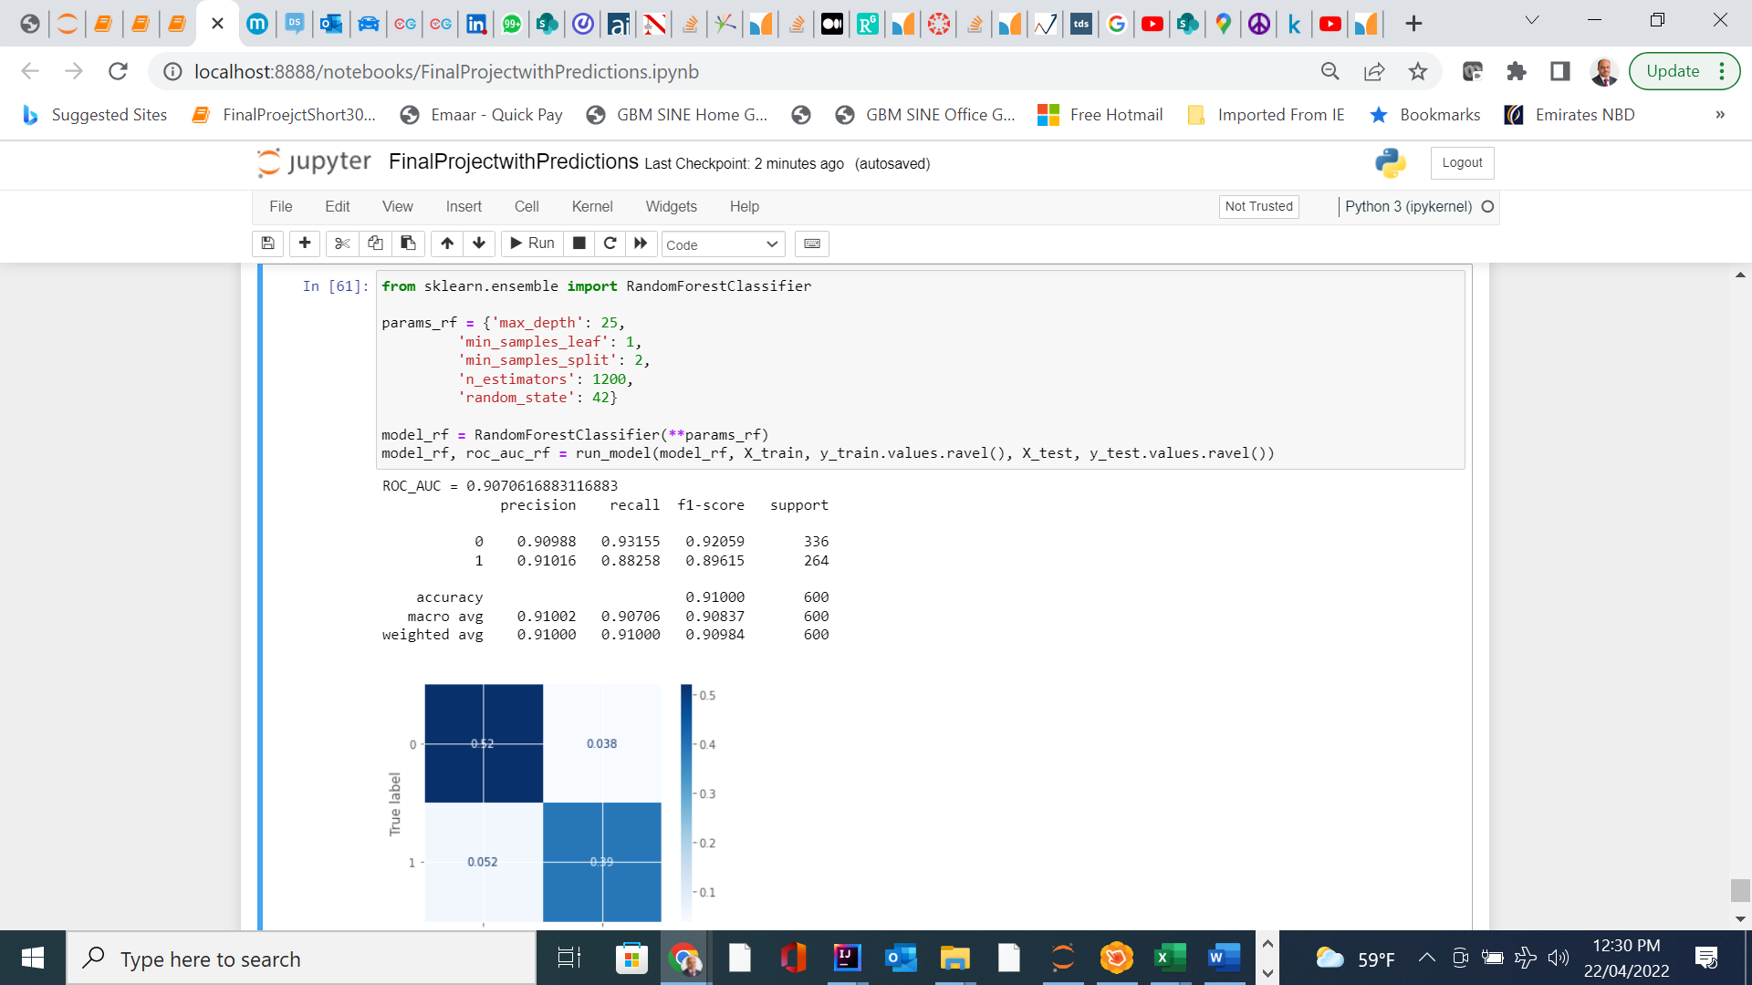
Tuning the model

Slide 22
Conclusions & final remarks
01
02
Our model did well in terns of overall accuracy ( close to 90 %)
Our model identified “ On-line Boarding “ & inflight wi-fi “ as most important features
After fine tuning max depths to 25 & N-estimators to 100 , we were able to improve accuracy to 91 %
We could achieve reasonable AUC for our testing data set
04
03

Slide 23

Question and Answer Segment

Slide 24
THANK YOU
Special thanks to Prof Pramod Gupta for his valuable teaching & guidance

